Slide 1

DATABASE SYSTEM FOR CONSUMER REVIEW ANALYSIS ON
Presenter: Le Kim Ngan Hoang (Kylie)
NetID: lkhoang2
IS 455 - MSIM

Slide 2
BACKGROUND & OBJECTIVES
Section 1
Background: Marketing
Acknowledge the database necessity in aligning shared understanding of customers & marketing performance over time
Objectives:
Utilizing available user review data of Yelp – consumer reviews platforms in the US & Canada
Seek to design & implement database system capable of generating meaningful insights into consumer behavior.
IS 455 - MSIM

Slide 3
USERS’ REQUIREMENTS
Section 2
1. Data requirements
Required data: Review data, users’ info, business’s info
Information should be able to link back to correct user or business
Duplicates should be avoided
2. Functional requirements
Systematically organized into well-defined relations
Data dictionaries should be provided
Support full cycle of data management activities
Support standardized and ad-hoc analyses
IS 455 - MSIM

Slide 4
USERS’ REQUIREMENTS
Section 2
3. Potential users : Business Managers, Marketing & Analytics team, Yelp Administrators
4. Access level:
Managers: Authorized to view their business’s datasets
Marketing & Analytics team: Extract for analytical purposes, model development,..etc
(Restricted from access to confidential users’ information )
Yelp admin: the highest authority, maintains data integrity by monitoring system access & potential security incidents
5. Authentication:
Each user has unique credentials & individual accounts
Email addresses should be masked, and IP addresses are strictly prevented
Only publicly available Yelp data will be utilized in this project
IS 455 - MSIM

Slide 5
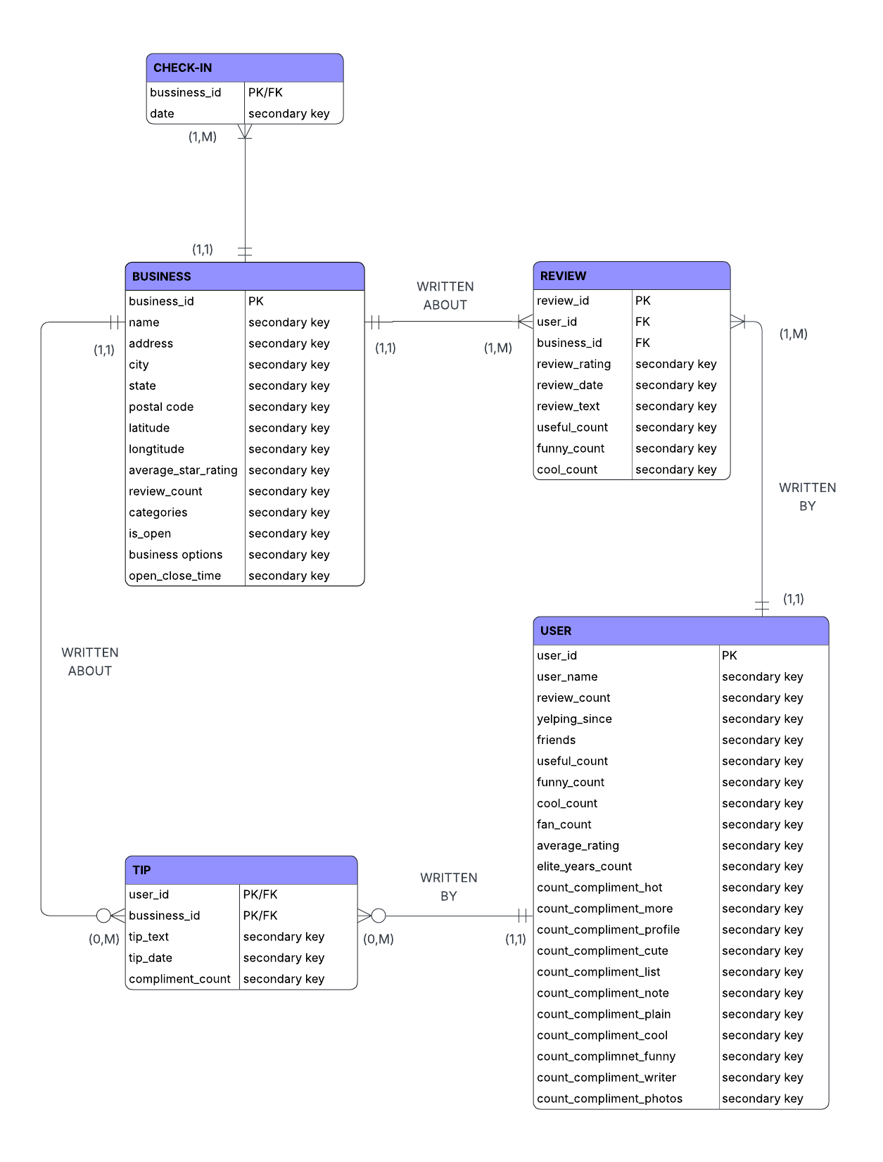
MAJOR ENTITIES & DESCRIPTION
Section 3
USER : The entity holds information about Yelp users
Attributes include user ID, name, number of reviews written, the date the user joined Yelp, their list of friends, and the number of votes (useful, funny, cool) they have given. Other attributes considered include fan count, elite years, average rating across reviews, and counts of compliments received in different categories (hot, cute, photos, etc.).

Slide 6
MAJOR ENTITIES & DESCRIPTION
Section 3
BUSINESS: This entity holds content about business listed on Yelp
The attributes that might be covered include business ID, name, address, city, state, postal code, latitude, longitude, average star rating, counts of reviews, and whether the business is open or not. It also stores information related to categories, opening hours, and business service attributes (like parking, takeout options).

Slide 7
MAJOR ENTITIES & DESCRIPTION
Section 3
REVIEW: Review entity represents feedback written for a business.
Attributes are review ID, user ID, business ID, and details of the star rating given, the date, the full review text, and counts of votes (useful, funny, cool)

Slide 8
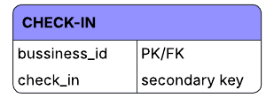
MAJOR ENTITIES & DESCRIPTION
Section 3
TIPS: Tips on Yelp short pieces of advice from users.
Attributes are text, date, number of compliments, user ID, and business ID
CHECK-IN: Visits to a business is recorded in this entity
Business ID and list of timestamps when check-ins occurred are recorded here.

Slide 9
BUSINESS RULES
Section 3
General understanding: Each company has a separate site on Yelp, so each review or tip value points to one business only
USER – REVIEW (1:M)
USER – TIP (1:M)
BUSINESS – REVIEW (1:M)
BUSINESS – TIP (1:M)
BUSINESS – CHECK-IN (1:M)
IS 455 - MSIM

Slide 10
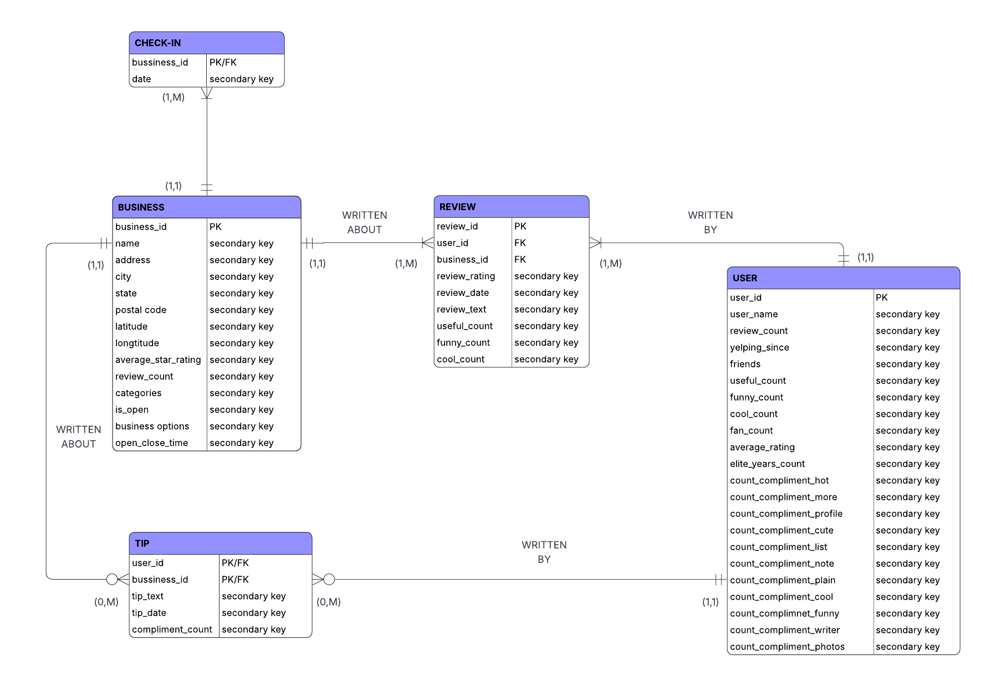
ER Diagram (Crow Foot Model)
Section 4

Slide 11
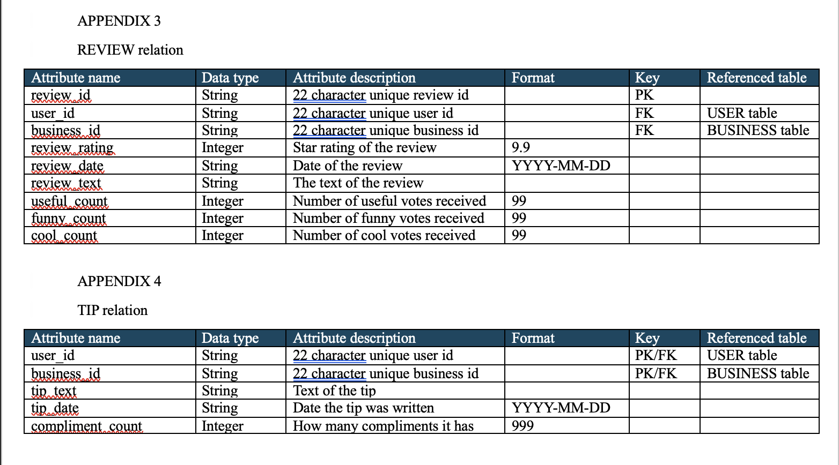
Sample Data dictionaries
Section 4

Slide 12
Sample Data dictionaries
Section 4
Note: samples for slide, full dictionaries in final report

Slide 13
Database Implementation
Section 5
Database: yelp_analysis (CREATE TABLE statements)
Data Insertion statements: Python scripts
  Read line-delimited JSON files & transform into relational entities
  Attribute names were mapped to schema conventions
  Non-relational attributes structure => JSON text (where applicable)
  Date in string datatype in raw file => DATETIME in MySQL
  Skip records with missing parent references, avoid duplicates insert
IS 455 - MSIM

Slide 14
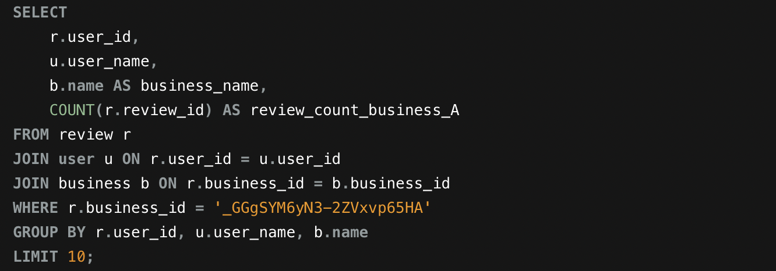
SQL Sample queries
Section 5
Query 1: To find out top 10 users with the highest number of reviews written for business A.
Sample report: The query helps find the users who have written reviews for a specific business, and counts how many reviews each user has written for that business. This sample query involves joining three entities: REVIEW, USER, and BUSINESS to display the name of the review writer and the business. This query essentially helps managers see which users review their business and how active they are.

Slide 15
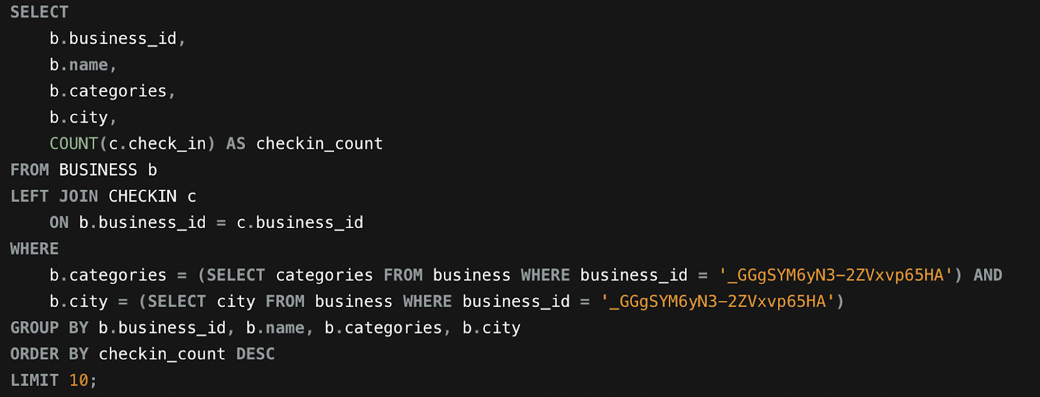
SQL Sample queries
Section 5
Query 2: To find out the top 10 same-category businesses with Business A in the same city with the highest number of check-ins
Sample report: The query finds other businesses in the same city and in the same category as the chosen business (using business_id) and counts how many check-ins each one has. By filtering on category and city, the query helps managers to use their business_id to compare them with their local competitors. Ordering by the number of check-ins also helps identify which businesses are most visited among them.

Slide 16
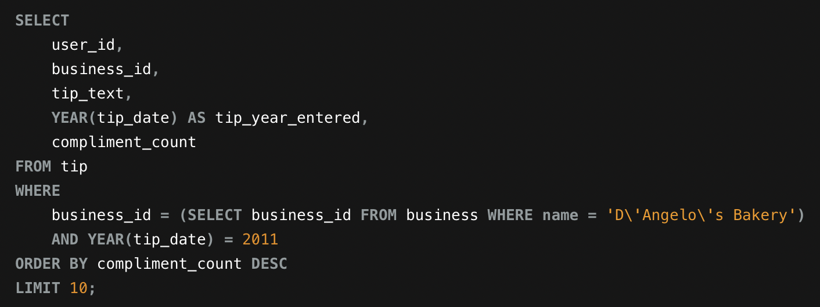
SQL Sample queries
Section 5
Query 3: To check the count of compliments for the tips given to D’s Angelo Bakery in year 2011
Sample report: Sort the table TIP based on business_ID of the business, then take the year from the date string given in the ‘date’ attribute to sort and have the ‘count of compliments’ for each tip illustrated in the final report.

Slide 17
Database Evaluation plan
Section 5
Criterion: integrity, security, accuracy, performance, scalability, maintainability
Methods:
  Integrity : verify relationship + check duplicates
  Security: test access rights, password, audit trails, diskless workstation
  Performance & accuracy: confirm SQL queries result, test operations function & insertion performance
  Maintainability & scalability: review schema design, check documentation and evaluate design and normalization process to limit redundancy and support storage
IS 455 - MSIM

Slide 18
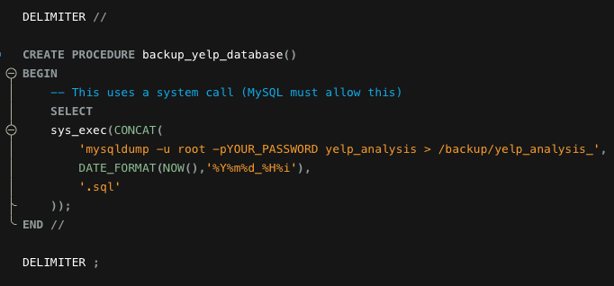
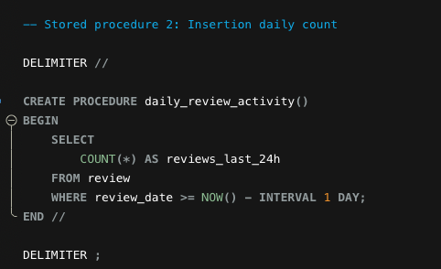
Database Administration
Section 5
2 sample stored procedures
Note: implemented 3 stored procedure, present 2 here on presentation slides
IS 455 - MSIM

Slide 19
Database Administration
Section 5
Stored procedure 1 : The first procedure was written to report database statistics, including table sizes and total row counts. This procedure would help the administrator inspect the storage usage and identify the fast-growing tables
Stored procedure 2: As REVIEW and USER are two entities that grow rapidly, the second routine was implemented to automatically back up the database by running a system-level mysqldump command and exporting data to timestamped backup files. The main purpose of this procedure protect Yelp from accidental data loss.
IS 455 - MSIM

Slide 20
THANK YOU FOR LISTENING !
IS 455 - MSIM

